Slide 1
Hotel reservation application data exploration
From Aroha

Slide 2
Introduction
"hospitality industry" consists of hotels and food service
Any business which takes care of Accommodation and Food Service for a guest is considered as Hospitality industry
Resort Management
Hotel Management
Bed and Breakfast
Casino

Slide 3
Hotels & Reservation System
Visualize any hotel you stayed in. How did you book the room?
Did you reserve the room or just walked in to the hotel?
In an unplanned travel, you may walk into a hotel and look for a room.
In a planned travel, you do reserve the room by looking for some facilities and near by places so that its helpful in your travel requirement.

Slide 4
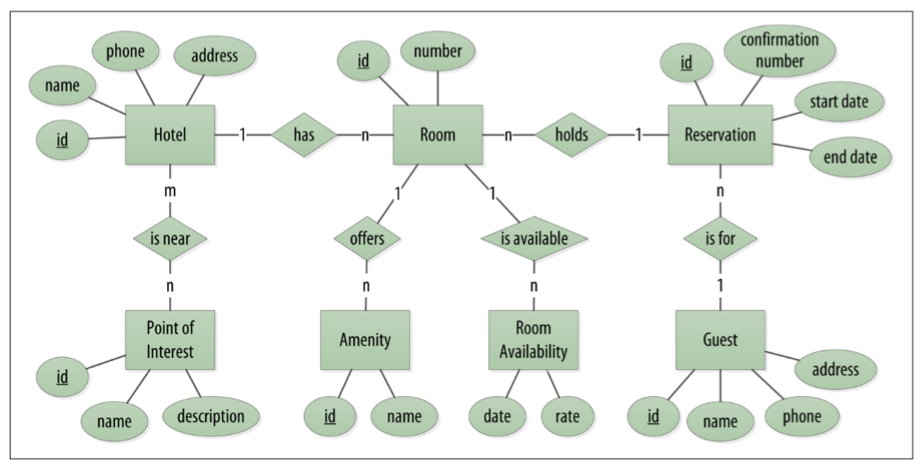
High Level Entity Definition and relationship

Slide 5
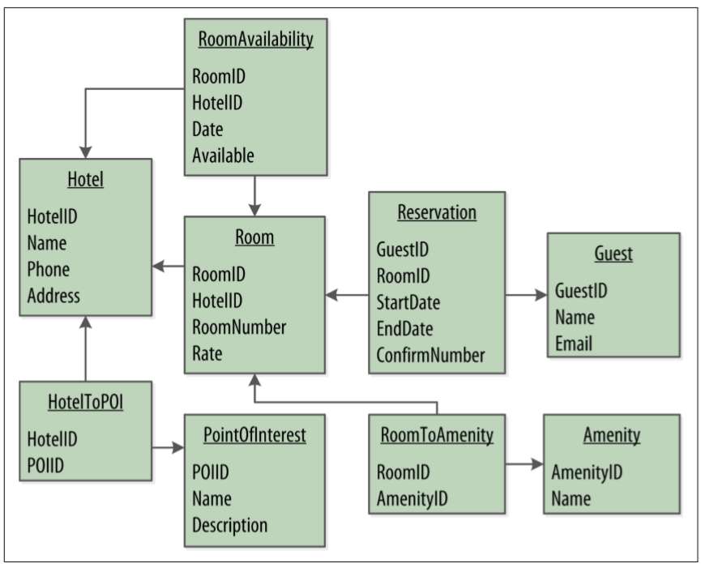
ER Model for Hotel Reservation

Slide 6
Typical Applications in this industry
CRM – Customer Relationship Management
Promotion Management
Loyalty Management
Lead Management System
Social Network Presence and Monitoring (Digital presense)
Reservation Systems to take care of Guest Reservations, cancellations and Billing.
Partner share management System (OYO, cleartrip)
Financial Systems for AR & AP
Spa / Restaurant Management System
VMS – Vendor Management System
Facilities Management
Travel Agents
Man Power Suppliers

Slide 7
Thank you
By Aroha

